Slide 1

Slide 10- 1
Notes:
1

Slide 2
Chapter 10
Functional Dependencies and Normalization for Relational Databases
Copyright © 2007 Ramez Elmasri and Shamkant B. Navathe
Notes:
2

Slide 3
1.1 Semantics of the Relation Attributes
GUIDELINE 1: Informally, each tuple in a relation should represent one entity or relationship instance. (Applies to individual relations and their attributes).
Attributes of different entities (EMPLOYEEs, DEPARTMENTs, PROJECTs) should not be mixed in the same relation
Only foreign keys should be used to refer to other entities
Entity and relationship attributes should be kept apart as much as possible.
Bottom Line: Design a schema that can be explained easily relation by relation. The semantics of attributes should be easy to interpret.
Slide 10- 3
Notes:
3

Slide 4
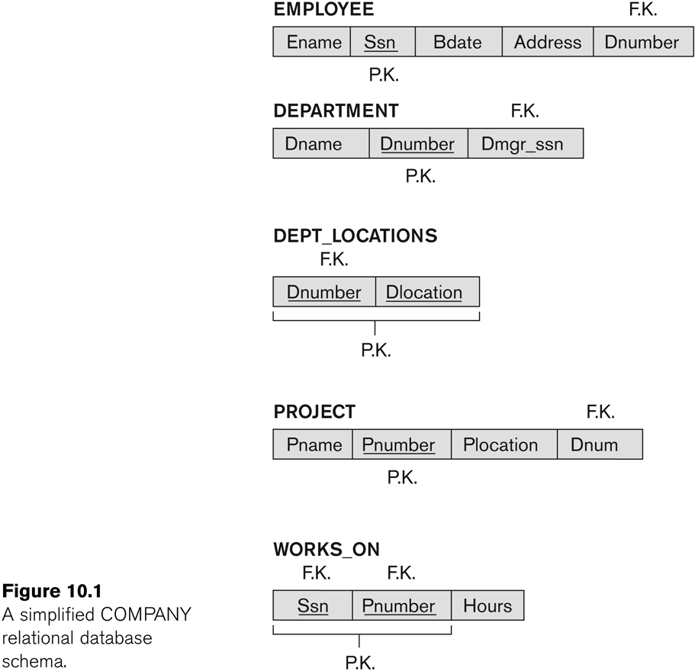
Figure 10.1 A simplified COMPANY relational database schema
Slide 10- 4
Notes:
4

Slide 5
1.2 Redundant Information in Tuples and Update Anomalies
Information is stored redundantly
Wastes storage
Causes problems with update anomalies
Insertion anomalies
Deletion anomalies
Modification anomalies
Slide 10- 5
Notes:
5

Slide 6
EXAMPLE OF AN UPDATE ANOMALY
Consider the relation:
EMP_PROJ(Emp#, Proj#, Ename, Pname, No_hours)
Update Anomaly:
Changing the name of project number P1 from “Billing” to “Customer-Accounting” may cause this update to be made for all 100 employees working on project P1.
Slide 10- 6
Notes:
6

Slide 7
EXAMPLE OF AN INSERT ANOMALY
Consider the relation:
EMP_PROJ(Emp#, Proj#, Ename, Pname, No_hours)
Insert Anomaly:
Cannot insert a project unless an employee is assigned to it.
Conversely
Cannot insert an employee unless an he/she is assigned to a project.
Slide 10- 7
Notes:
7

Slide 8
EXAMPLE OF AN DELETE ANOMALY
Consider the relation:
EMP_PROJ(Emp#, Proj#, Ename, Pname, No_hours)
Delete Anomaly:
When a project is deleted, it will result in deleting all the employees who work on that project.
Alternately, if an employee is the sole employee on a project, deleting that employee would result in deleting the corresponding project.
Slide 10- 8
Notes:
8

Slide 9
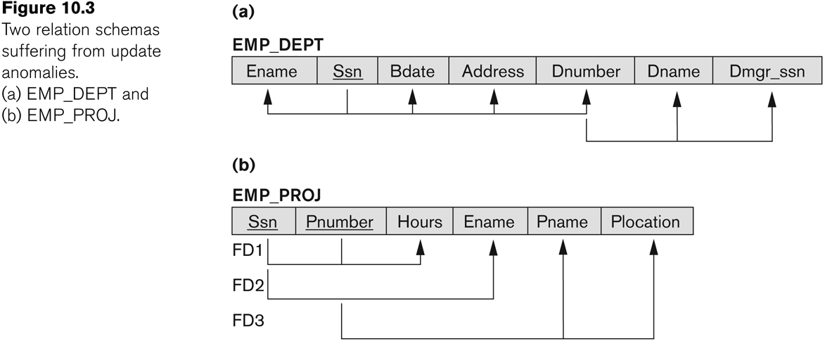
Figure 10.3 Two relation schemas suffering from update anomalies
FD: Functional Dependencies will be discussed in upcoming slides
Slide 10- 9
Notes:
9

Slide 10
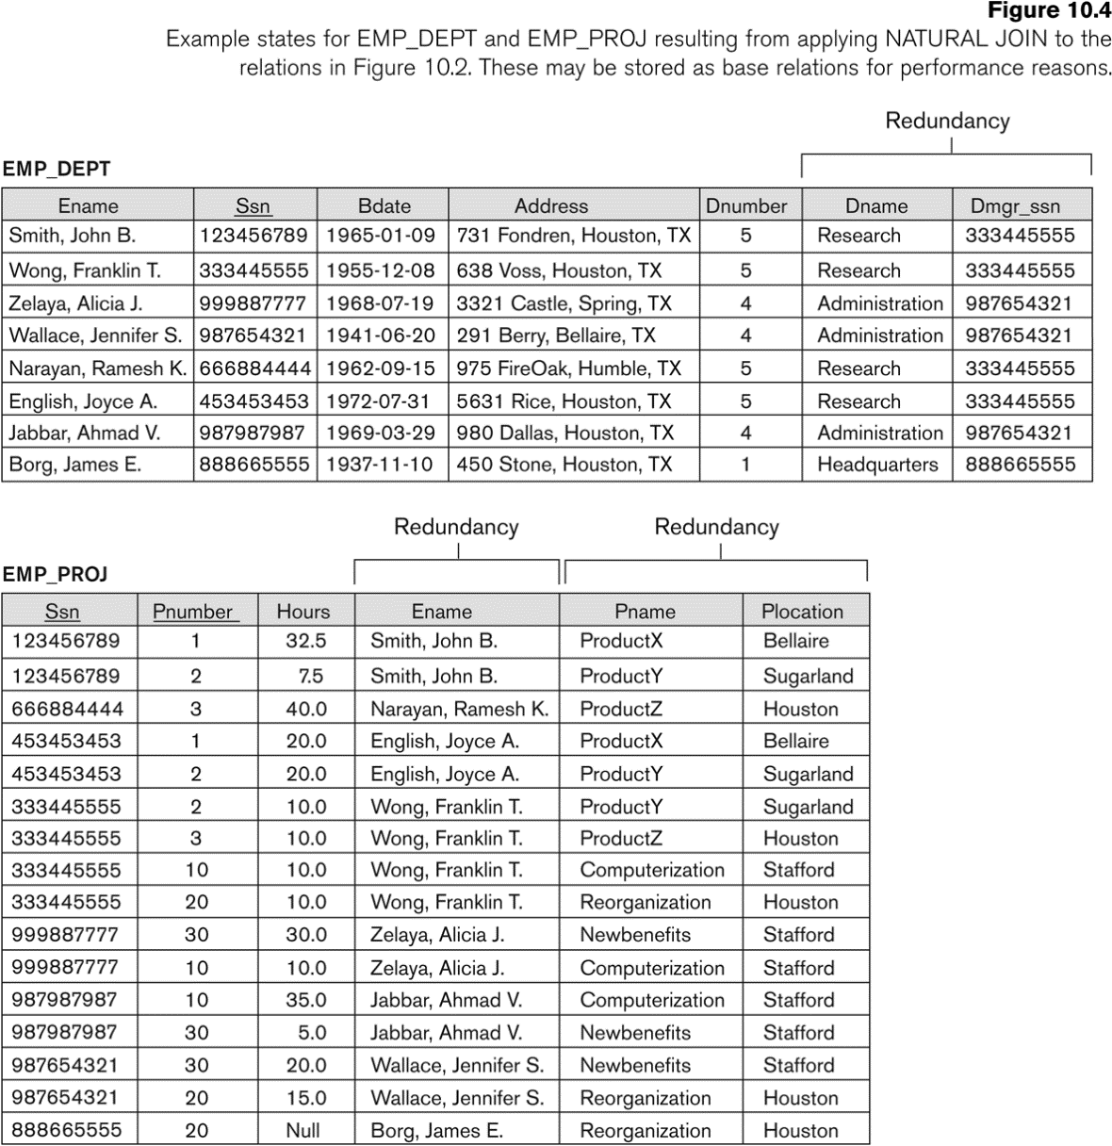
Figure 10.4 Example States for EMP_DEPT and EMP_PROJ
Slide 10- 10
Notes:
10

Slide 11
Guideline to Redundant Information in Tuples and Update Anomalies
GUIDELINE 2:
Design a schema that does not suffer from the insertion, deletion and update anomalies.
If there are any anomalies present, then note them so that applications can be made to take them into account.
Slide 10- 11
Notes:
11

Slide 12
1.3 Null Values in Tuples
GUIDELINE 3:
Relations should be designed such that their tuples will have as few NULL values as possible
Attributes that are NULL frequently could be placed in separate relations (with the primary key)
Reasons for nulls:
Attribute not applicable or invalid
Attribute value unknown (may exist)
Value known to exist, but unavailable
Slide 10- 12
Notes:
12

Slide 13
1.4 Spurious Tuples
Bad designs for a relational database may result in erroneous results for certain JOIN operations
The "lossless join" property is used to guarantee meaningful results for join operations
GUIDELINE 4:
The relations should be designed to satisfy the lossless join condition.
No spurious tuples should be generated by doing a natural-join of any relations.
Slide 10- 13
Notes:
13

Slide 14
Spurious Tuples (2)
There are two important properties of decompositions:
Non-additive or losslessness of the corresponding join
Preservation of the functional dependencies.
Note that:
Property (a) is extremely important and cannot be sacrificed.
Property (b) is less stringent and may be sacrificed. (We will see later).
Slide 10- 14
Notes:
14

Slide 15
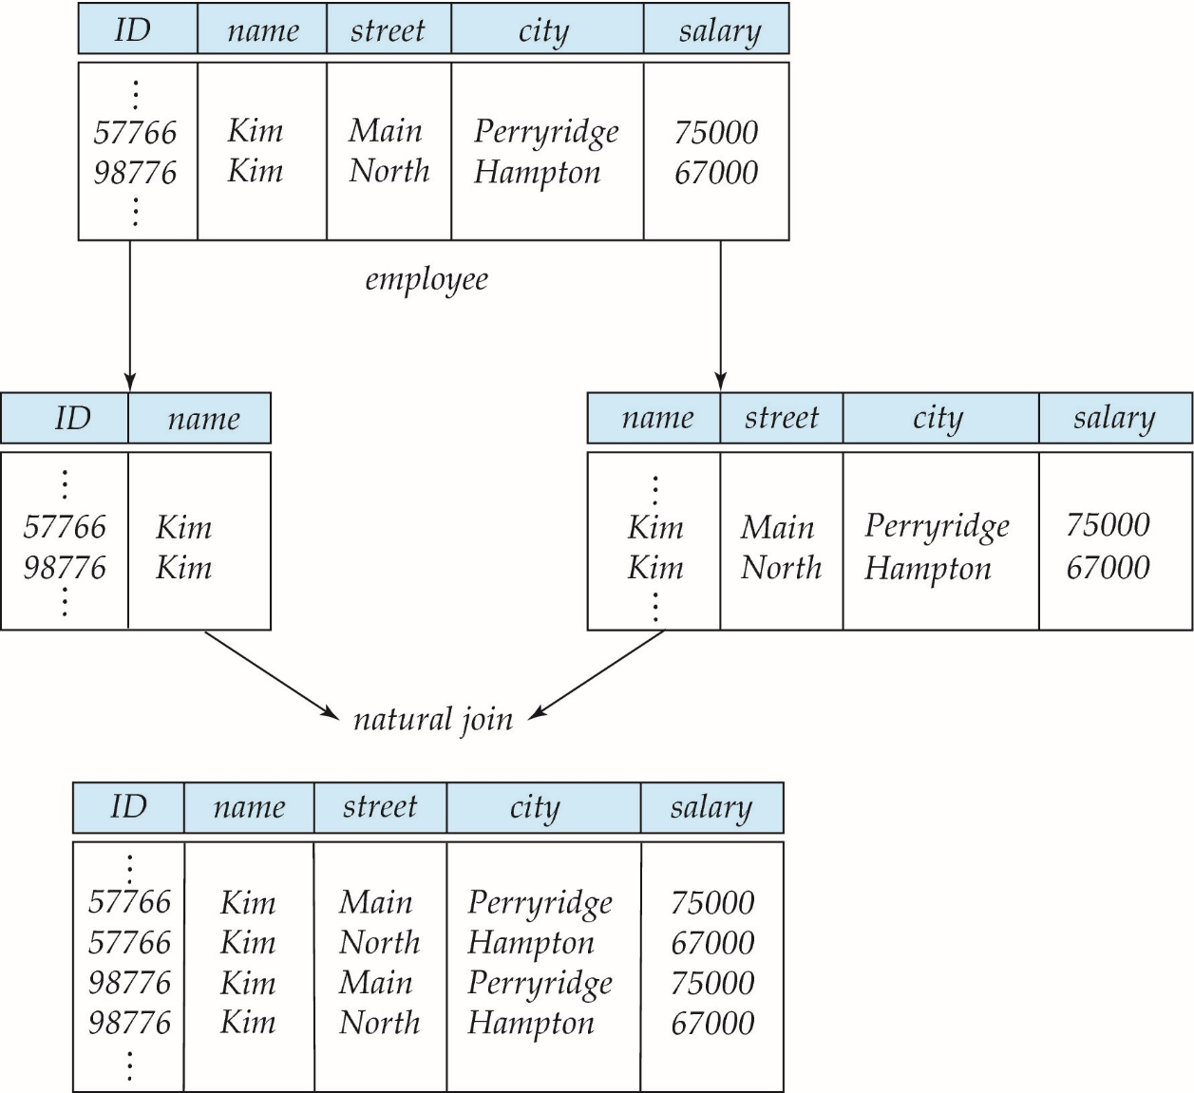
A Lossy Decomposition
Extra Tuples.. Two tuples have become Four !!!
Tuples are not lost. Information is lost.
Notes:
15

Slide 16
Example of Lossless-Join Decomposition
Lossless join decomposition
Decomposition of R = (A, B, C) R₁ = (A, B) R₂ = (B, C)
A
B
C
A
B
B
C
α
β
1
2
A
B
α
β
1
2
1
2
A
B
r
∏_{A,B}(r)
∏_{B,C}(r)
∏_{A} (r) ∏_{B} (r)
A
B
C
α
β
1
2
A
B
Notes:
16

Slide 17
3.1 Normalization of Relations (1)
Normalization:
Takes a relation schema through a series of tests to certify whether it satisfies a certain normal form and subsequently, decompose the relation as necessary.
Normal form:
There are several standard or normal forms defined for database design and the relation is said to be in particular normal form if it satisfies some constraints.
Slide 10- 17
Notes:
17

Slide 18
Normalization of Relations (2)
2NF, 3NF, BCNF
based on keys and FDs of a relation schema
4NF
based on keys, multi-valued dependencies : MVDs; 5NF based on keys, join dependencies : JDs (Chapter 11)
Additional properties may be needed to ensure a good relational design (lossless join, dependency preservation)
Slide 10- 18
Notes:
18

Slide 19
3.2 Practical Use of Normal Forms
Normalization is carried out in practice so that the resulting designs are of high quality and meet the desirable properties
The practical utility of these normal forms becomes questionable when the constraints on which they are based are hard to understand or to detect
The database designers need not normalize to the highest possible normal form
(usually up to 3NF, BCNF or 4NF)
Denormalization:
The process of storing the join of higher normal form relations as a base relation—which is in a lower normal form
Slide 10- 19
Notes:
19

Slide 20
3.3 Definitions of Keys and Attributes Participating in Keys (1)
A superkey of a relation schema R = {A1, A2, ...., An} is a set of attributes S subset-of R with the property that no two tuples t1 and t2 in any legal relation state r of R will have t1[S] = t2[S]
A key K is a superkey with the additional property that removal of any attribute from K will cause K not to be a superkey any more.
Slide 10- 20
Notes:
20

Slide 21
Definitions of Keys and Attributes Participating in Keys (2)
If a relation schema has more than one key, each is called a candidate key.
One of the candidate keys is arbitrarily designated to be the primary key, and the others are called secondary keys.
A Prime attribute must be a member of some candidate key
A Nonprime attribute is not a prime attribute—that is, it is not a member of any candidate key.
Slide 10- 21
Notes:
21

Slide 22
3.2 First Normal Form
Disallows
composite attributes
multivalued attributes
nested relations; attributes whose values for an individual tuple are non-atomic
Considered to be part of the definition of relation
Slide 10- 22
Notes:
22

Slide 23
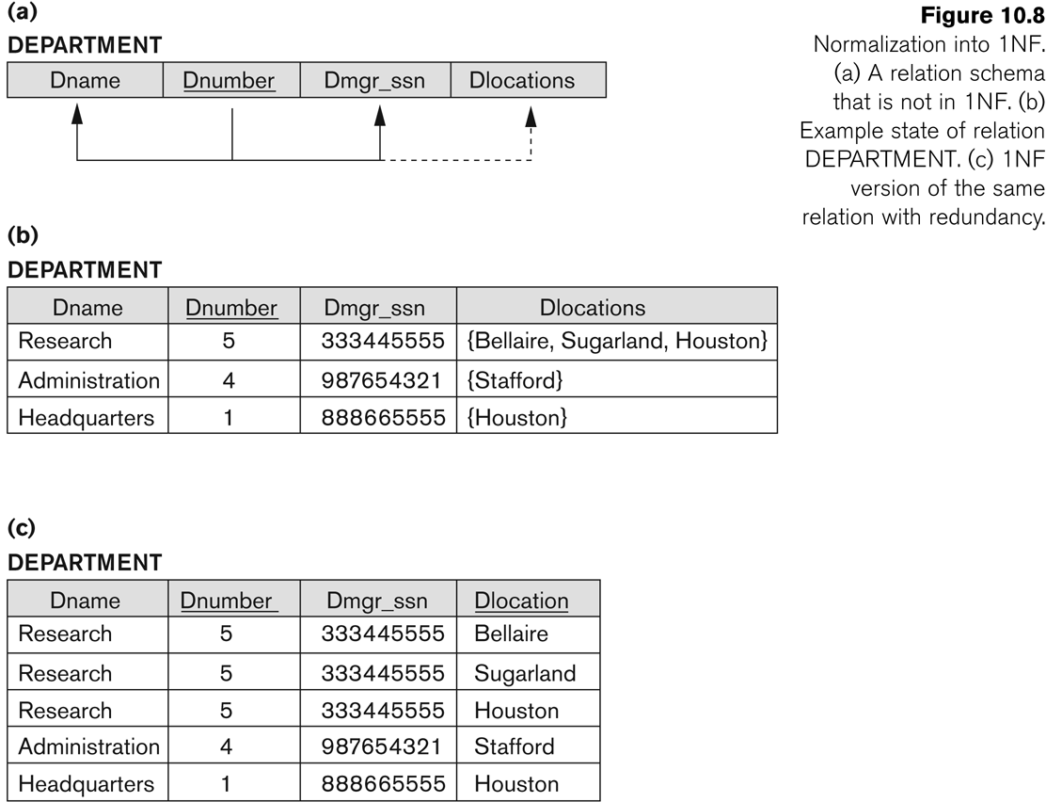
Figure 10.8 Normalization into 1NF
Slide 10- 23
Notes:
23

Slide 24
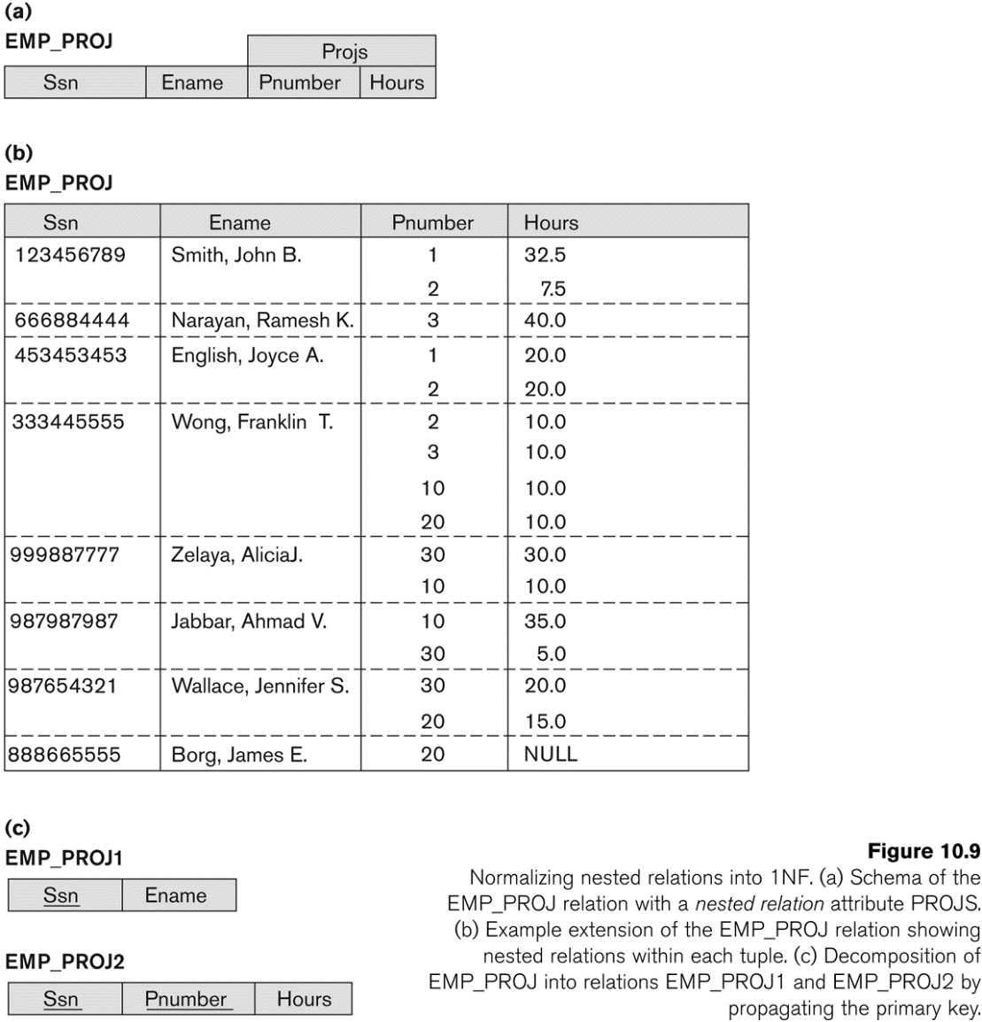
Figure 10.9 Normalization nested relations into 1NF
Slide 10- 24
Notes:
24

